Slide 1
IEEE standards
IEEE 802.3 Ethernet
802.4
802.5

Slide 2
In 1985, the Computer Computer Society Society of the IEEE started started a project, project, called Project Project 802, to set standards standards to enable intercommunication intercommunication among equipment equipment from a variety variety of manufacturers manufacturers. Project Project 802 is a way of specifying specifying functions functions of the physical physical layer and the data link layer of major LAN protocols protocols.

Slide 3
Ethernet 802.3
LAN technology
Topology used – bus
Media Access control method- CSMA /CD
Data rate :10 Mbps,100 Mbps,1 Gbps,10Gbps
Encoding techniques used : Manchester Encoding
Ethernet Address : MAC Address
baseband transmission technique

Slide 4
Ethernet Address
End nodes are identified by their Ethernet Addresses (MAC Address or Hardware Address) which is a unique 6 Byte address
MAC Address is represented in Hexa Decimal format e.g 00:05:5D:FE:10:0A
The first 3 bytes identify a vendor (also called prefix) and the last 3 bytes are unique for every host or device

Slide 5
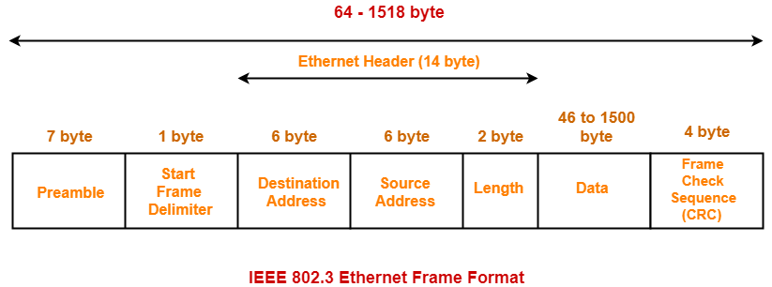
Ethernet Frame Structure

Slide 6
Preamble:
7 bytes with pattern 10101010
indicates starting of the frame and allow sender and receiver to establish bit synchronization.
SFD
Start Frame Delimiter
Signals the beginning of the frame
10101011
Alerts the receiver that the next field is the destination address

Slide 7
Destination Address –
This is 6-Byte field which contains the MAC address of machine for which data is destined.
Source Address – This is a 6-Byte field which contains the MAC address of source machine.
As Source Address is always an individual address (Unicast), the least significant bit of first byte is always 0.
Length – Length is a 2-Byte field, which indicates the length of entire Ethernet frame.
This 16-bit field can hold the length value between 0 to 65534,
length cannot be larger than 1500 because of some own limitations of Ethernet.

Slide 8
Data –
This is the place where actual data is inserted, also known as Payload.
This field carries data encapsulated from the upper layer protocol.
Minimum of 46 and maximum of 1500 bytes.
Cyclic Redundancy Check (CRC)
error detection information
Note – Size of frame of Ethernet IEEE 802.3 varies 64 bytes to 1518 bytes including data length (46 to 1500 bytes).

Slide 9
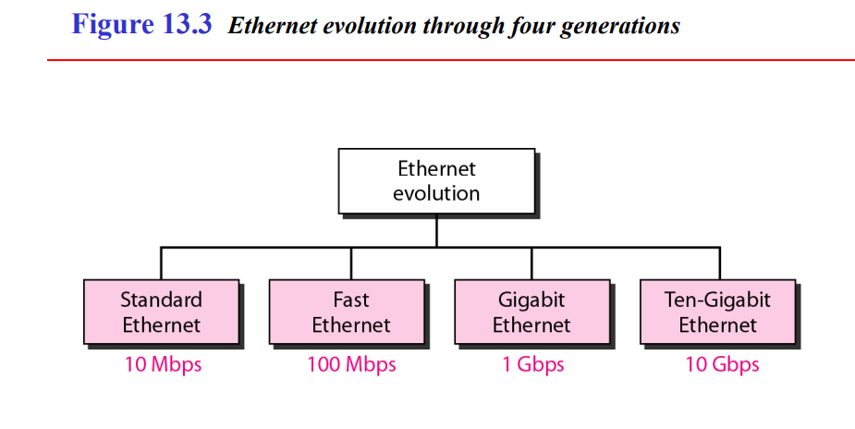

Slide 10
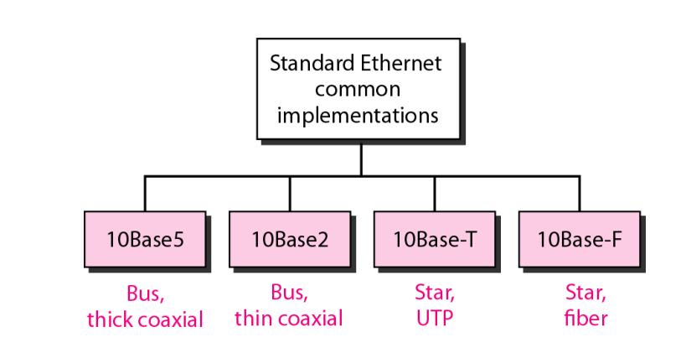

Slide 11
Token Bus (IEEE 802.4)
is a popular standard for the token passing LANs.
Signal speeds in the range 1 Mbps, 5 Mbps, and 10 Mbps are achievable.
Cabling used is coax cable
Is a broadband computer networks.
In a token bus LAN, the physical topology is a bus or a tree
and a logical ring is created using coaxial cable.
The token is passed from one user to other in a sequence.
A station can only transmit data when it has the token

Slide 12
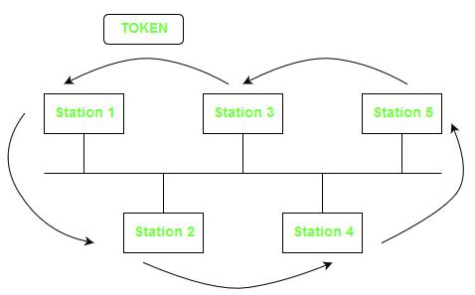

Slide 13
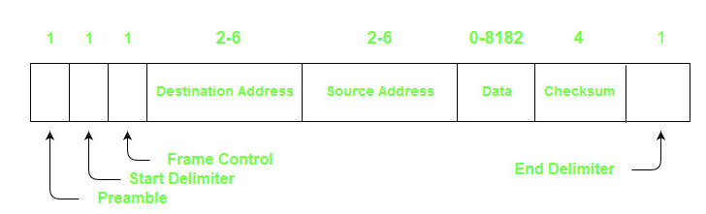
Frame Format:

Slide 14
Preamble: 1 byte for synchronization.
Start Delimiter: 1 byte that marks the beginning of the frame.
Frame Control: 1 byte that specifies whether this is a data frame or control frame.
Destination Address: 2-6 bytes that specifies address of destination station.
Source Address: 2-6 bytes that specifies address of source station.
Payload: A variable length field that carries the data from the network layer.
Checksum: 4 bytes frame check sequence for error detection.
End Delimiter: 1 byte that marks the end of the frame.

